Slide 1
BUILDLINK: A Construction Procurement Platform
OUR GUIDE:Mrs SHEENA S.
TEAM MEMBERS :B12
SIDHU SANGEERTH S – 20321082
TOVIN THANKACHAN THOMAS – 20321090
CHIRIYANKANDATH MELBIN SEBASTIAN
20221095
EFFIN JOE WILSON – 20221096

Slide 2
CONTENTS
1.Introduction
2.Basic Objectives
3.Simple DFD for functionality
4.Technical functionalities
5.Features
6.Phases
7.Requirements
8.Advantages
9.Dis-advantages
10.Future scope
11.Conclusion

Slide 3

What does procurement mean?
Procurement means the process of purchasing goods or services, between two modules usually in reference to business spending
Two modules:-USER & AGENT

Slide 4

Introduction
Build Link is a web-based platform aimed at revolutionizing the
construction industry by facilitating seamless collaboration and resource ex change between users and agents involved in the procurement process.
The platform caters to two primary user roles:
Users seeking construction re sources such as raw materials, machinery, and skilled labor, and
Agents ready to provide these essential services.

Slide 5
Basic Objectives
Build Trust and Transparency:
Verify all agents to prevent scams and ensure reliability.
Ensure transparency in pricing and availability of materials.
Enable Effective Communication:
Implement features for direct communication between users and agents(until a perfect Link is Established)
Verify Agents:
Implement a thorough verification process for agents to prevent scams and ensure authenticity.
Facilitate Connections:
connect with DIFFERENT verified agents who supply construction materials.

Slide 6
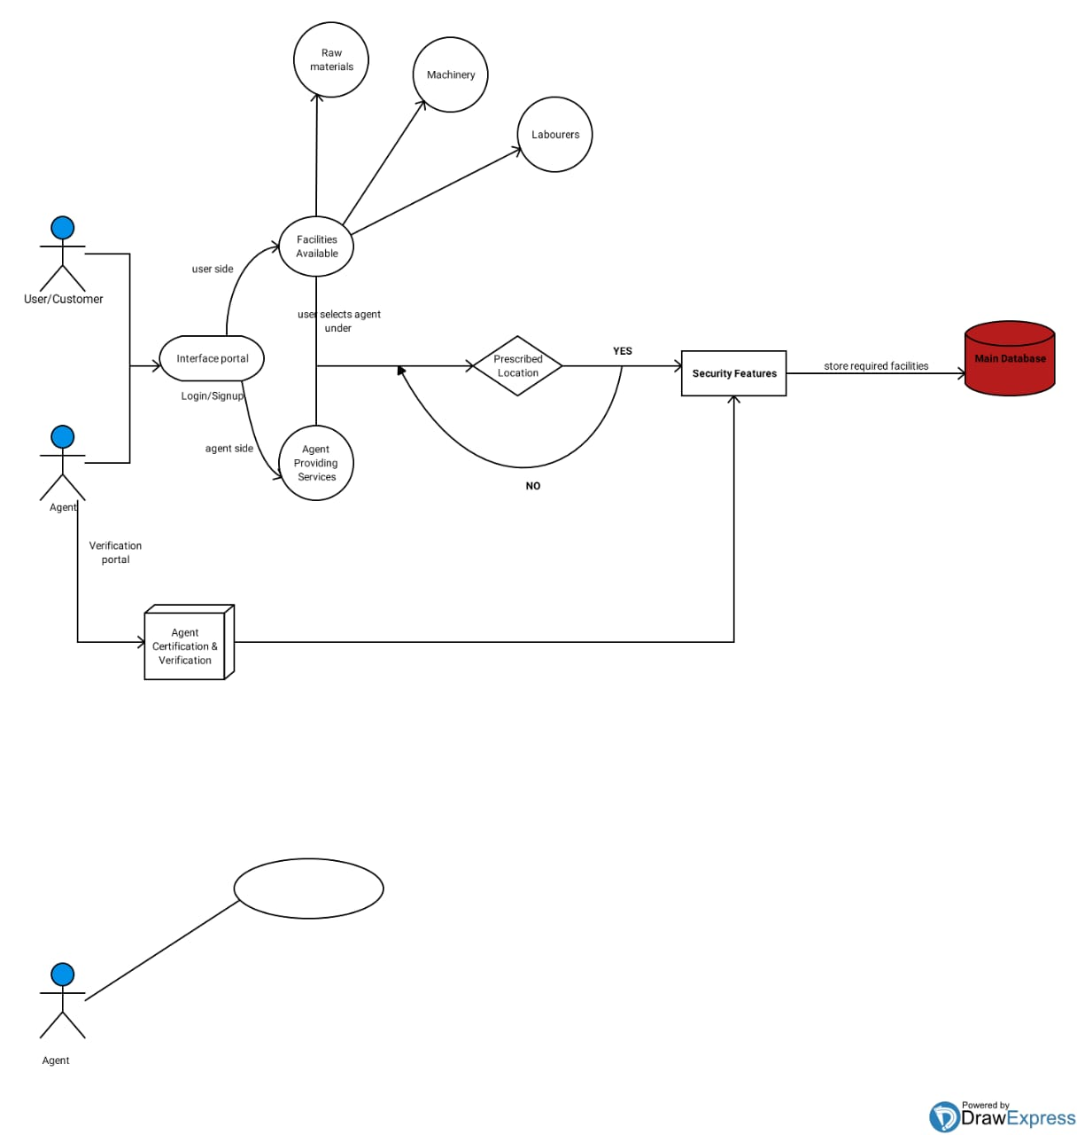

Slide 7
Technical functionalities
registration
Allows users and agents to create account
Services
Here agent will provide services TO THE USER ACCORDING TO THE USER REQUIREMENT
USER DASHBOARD
Users should have access to a dashboard where they can manage their profile, view transaction history, and track ongoing projects.
AGENT DASHBOARD
Allows users and agents to create account

Slide 8
SECURITY
Reduces the risk of scams by ensuring that all agents are legitimate and trustworthy.
platform interface
User-friendly interface for easy navigation and finding volunteer opportunities
resource posting
Agents should be able to post listings for construction resources including raw materials, machinery, and skilled labor.
resource search
Users should be able to search for resources based on various criteria such as type, location, and availability.

Slide 9
FEATURES
AUTHENTICATION
Users and agents must be able to register and log in to their respective accounts
Authentication mechanisms should ensure security and data privacy
USER DASHBOARD
Users should have access to a dashboard where they can manage their profile, view transaction history, and track
ongoing projects
AGENT DASHBOARD
Agents should have a dedicated dashboard to showcase their offerings, manage listings, and track transactions
RESOURCE POSTING
Agents should be able to post listings for construction resources including raw materials, machinery, and skilled labor.
Listings should include detailed information about the resource, pricing, and availability.

Slide 10
RESOURCE SEARCH
Users should be able to search for resources based on various criteria such as type, location, and availability
The search functionality should be Intuitive and provide relevant results.
REAL TIME TRACKING
Users should be able to track the status of their transactions and projects in Realtime.
Agents should provide updates on the progress of resource delivery or service completion

Slide 11
PHASES
INITIATION
Identify the need for the BUILDLINK and for what purpose we are creating the project and who are the beneficiary
PLANNING
Define project scope, objective, create project plan with timelines and
milestones
DESIGN
-UI/UX Design: - Design user interface
and experience.
TESTING
- Conduct thorough testing and bug fixes.

Slide 12
DATABASE AND BACKEND DEVELOPMENT
Set up database for user profiles, agent profile, events, and Develop backend logic for user interaction
FRONTEND DEVELOPMENT
Implement using basic front-end functionalities,like HTML,CSS,Bootstrap,MongoDB
SECURITY
Verify all agents to prevent scams and ensure reliability and ensure security for user and agent data
TESTING
Conduct thorough testing and bug fixes.

Slide 13
Requirements
HTML
EXPRESS
CSS
NODE
BOOTSTRAP
MONGO DB

Slide 14
Advantages
Trust and Security
Verified Agents: Reduces the risk of scams by ensuring that all agents are legitimate and trustworthy.
Transparency
User Reviews and Ratings: Provides transparency on agent reliability and material quality.
Price Comparison: Allows users to compare prices from different agents to get the best deals.
Quality and Variety
High-Quality Materials: Access to a wide range of high-quality construction materials.
Agent Benefits
Broader Reach: Helps agents showcase their products to a larger audience.

Slide 15
Disadvantages
Initial Trust Building
New Platform: May take time to build trust and credibility among users and agents, especially if the platform is new.
Verification Process
Time-Consuming Verification: Thorough verification of agents might be time-consuming, potentially delaying the onboarding process.
Dependence on Internet Access
Connectivity Issues: Users and agents in areas with poor internet connectivity might face challenges accessing the platform.
Cost of Development and Maintenance
High Costs: Developing and maintaining a feature-rich, secure platform can be expensive.

Slide 16
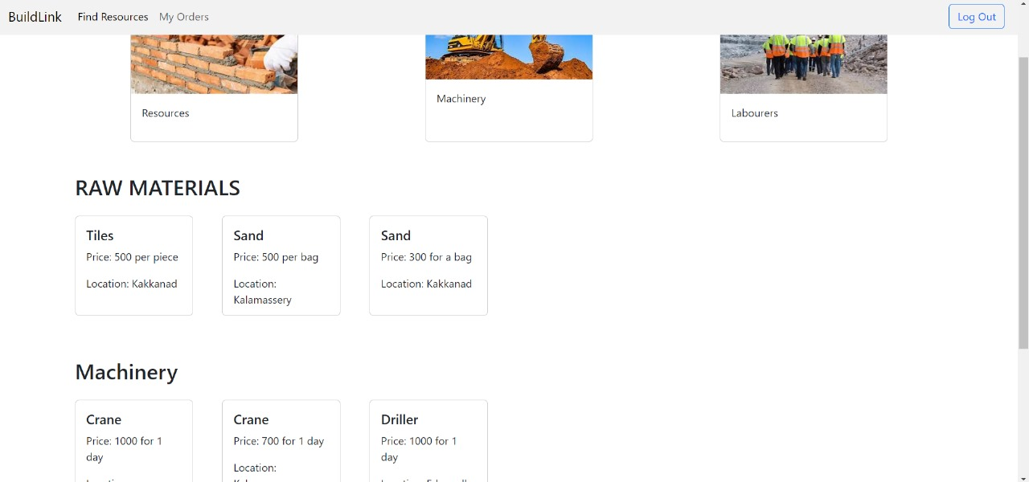

Slide 17
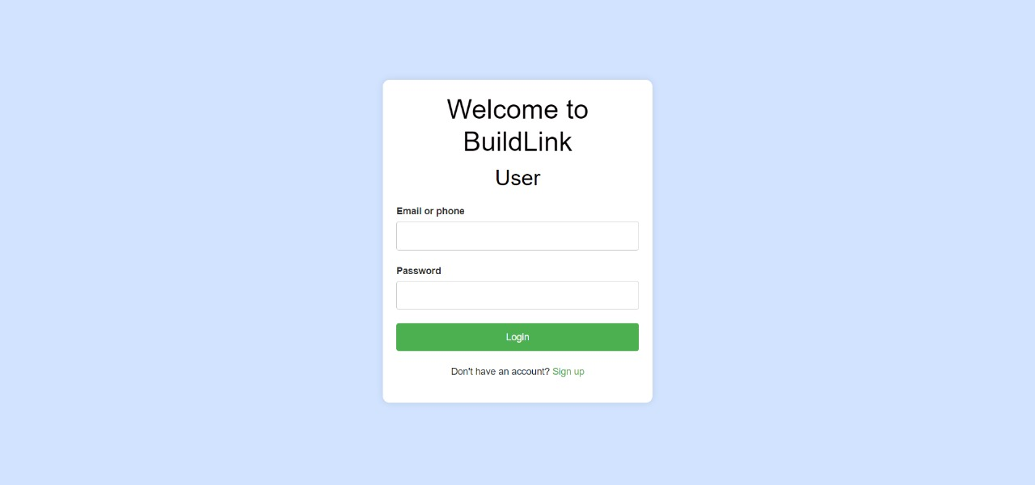

Slide 18
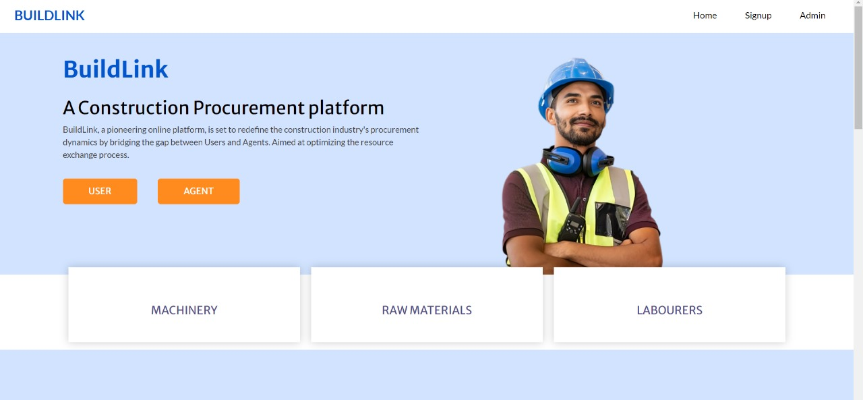

Slide 19
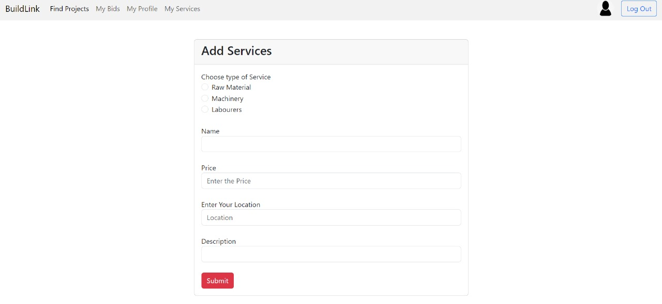

Slide 20
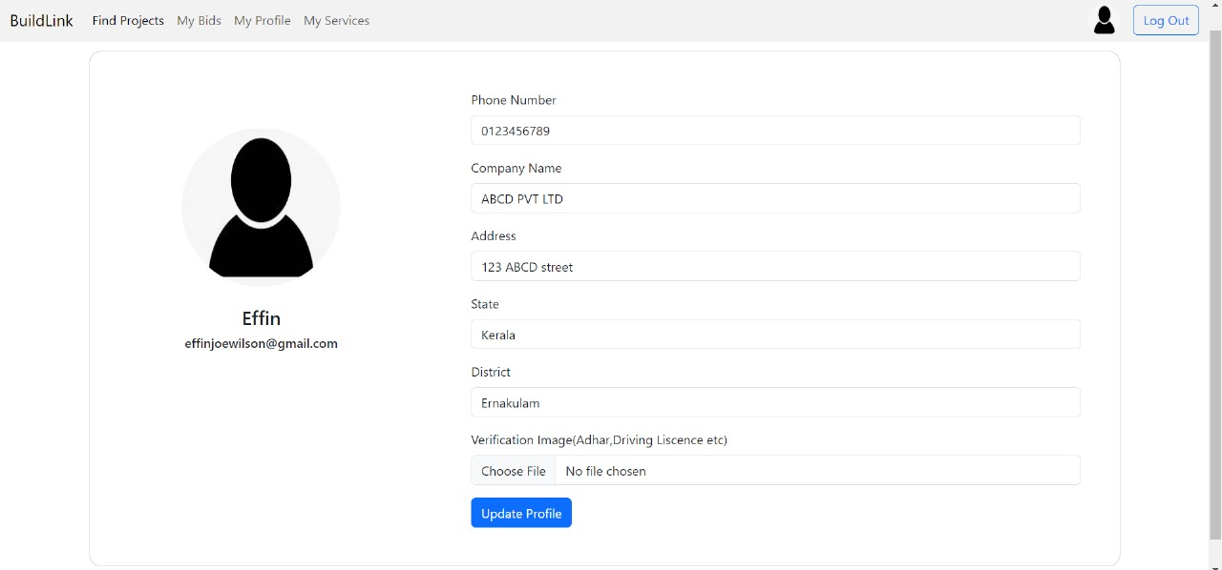

Slide 21
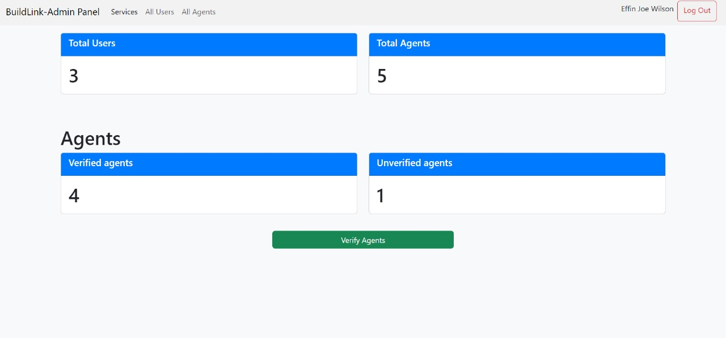

Slide 22
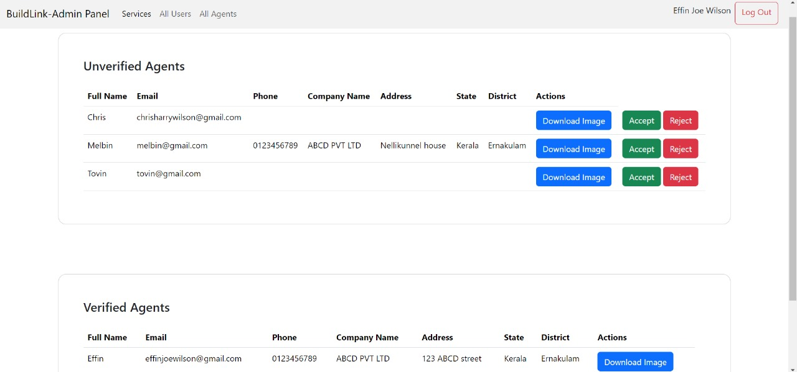

Slide 23
Future Scope
1. Messaging Features:
Develop robust messaging features, including direct messaging, group chats, and secure document sharing within the chat interface. This will improve communication between Users and Agents, facilitating quicker decision-making and more effective collaboration.
2.Transaction Features:
Implement secure transaction features, allowing Users to request quotes, place orders, and make payments directly through the platform. This will stream line the procurement process, making it more efficient and secure for both Users and Agents.
3. Expansion to Include Industry Networks:
Expand the platform to include a network of industry professionals, allowing Users to connect with experts, mentors, and potential business partners. This feature can provide valuable networking opportunities and support pro fessional growth and collaboration.

Slide 24
4. Virtual Events and Webinars:
Develop capabilities for hosting virtual events, webinars, and live-streamed sessions. This will allow the construction community to engage in real-time interactions, attend industry conferences, and participate in training sessions from anywhere in the world.
5. Mobile App Enhancements:
Continuously improve and update the mobile app version of BuildLink, adding new features, optimizing performance, and ensuring a seamless user experience across different devices. This will enable Users and Agents to manage their activities on the go.
6. Accessibility and Inclusivity:
Focus on improving accessibility features to ensure that users with disabilities can access and navigate the platform effectively. Consider features such as screen reader compatibility, color contrast options, and keyboard navigation to create an inclusive environment for all users.

Slide 25
Conclusion
The implementation of Build Link has demonstrated significant improvements in construction procurement by addressing the challenges of the user-agent-gap. Its impact is poised to drive further advancements in the industry, creating a more efficient and collaborative ecosystem.
.

Slide 26
Thank you
By Batch B12

